Slide 1
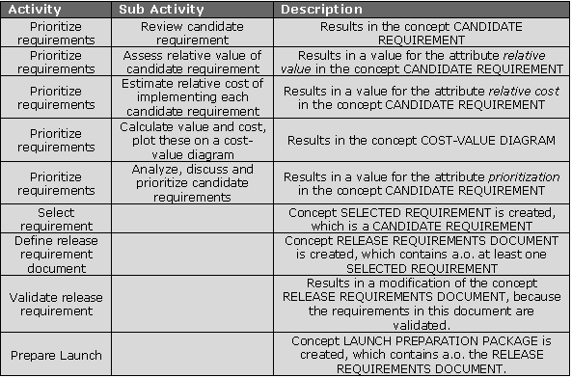
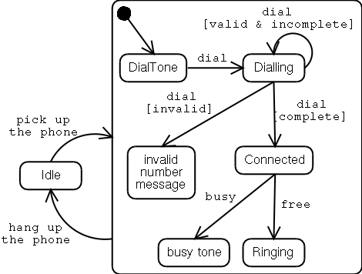

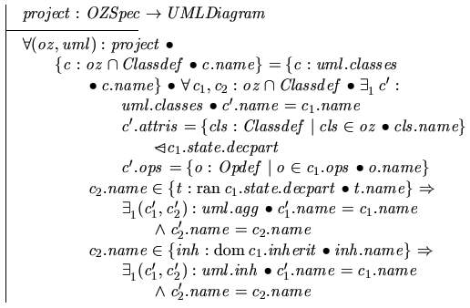
The Role of Design
Requirements
Design Models
Code
Design should play a pivotal role:
the process of converting a system specification into an executable system.

Slide 2
Software Design Process
A Process is a set of related and (sequenced) tasks that transforms a set of input to a set of output.
Inputs
Design
Process
Outputs
requirements
specifications
sequence of tasks
design
specifications

Slide 3
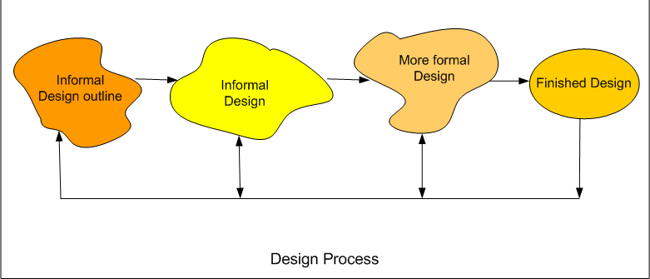
Software design process
Software designers do not arrive at a finished design immediately. They develop design iteratively through number of different versions. The starting point is informal design which is refined by adding information to make it consistent and complete as shown in the figure below:
As a design is decomposed, errors and omissions in earlier stages are discovered. These feed back to allow earlier design models to be improved.
A specification for the next stage is the output of each design activity.
The final results of the process are precise specifications of the algorithms and data structures to be implemented.
Design activities can be broadly classified into two important parts:
• Preliminary (or high-level) design and
• Detailed design.
High-level design means identification of different modules and the control relationships among them and the definition of the interfaces among these modules. The outcome of high-level design is called the program structure or software architecture.
During detailed design, the data structure and the algorithms of the different modules are designed. The outcome of the detailed design stage is usually known as the module-specification document.

Slide 4
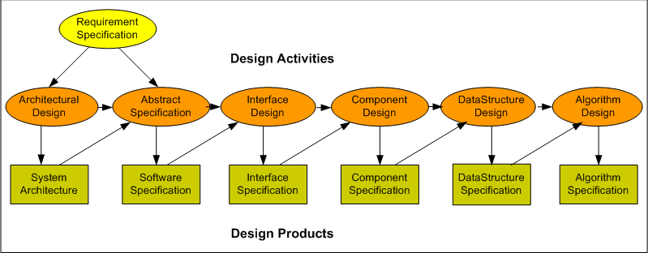
A general model of software design process

Slide 5
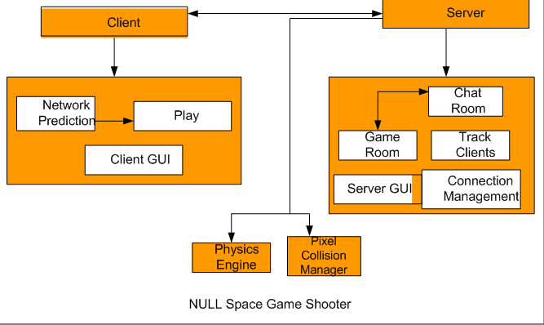
Architectural design
Identifying and documenting the sub-systems making up the system and their relationships
Explained using the following architecture

Slide 6
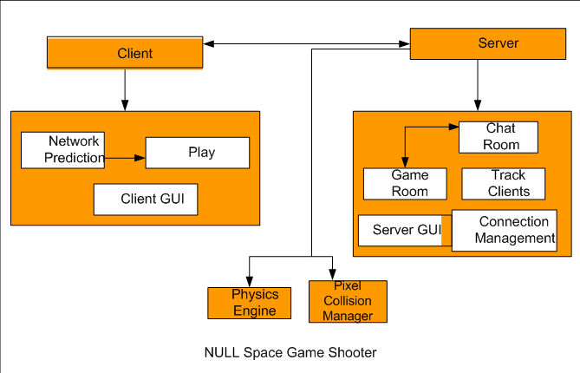
Architectural Design
Client and Server are the subsystems that are controlling the other modules.
Other modules are the rectangles in white. Ex, Network Prediction, Play, Chat Room, Game Room etc.
Activities necessary for architectural designing;
 System Structuring
 Control modeling
 Modular decomposition
The output of the architectural design process is an architectural design document.

Slide 7
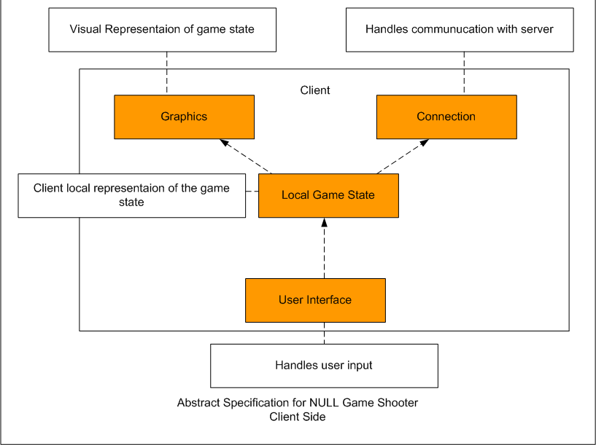
Abstract specification
For each sub-system, an abstract specification of the services it provides and the constraints under which it must operate is produced.

Slide 8

Abstract specification
Orange Boxes are the subsystems.
White Boxes are the services provided by the subsystems.
Services include
  Visual
  Representation
  Communication
  Layer
  User I/O
  Client Side Copy

Slide 9
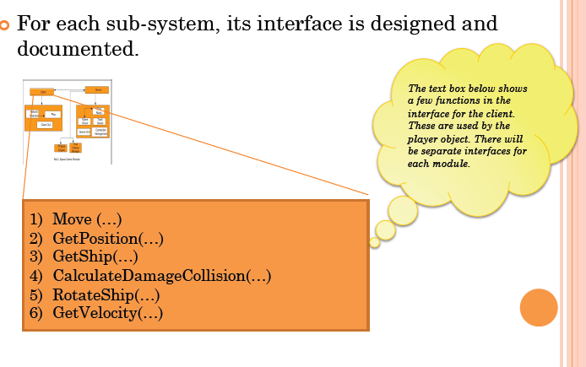
Interface design
For each sub-system, its interface is designed and documented.

Slide 10
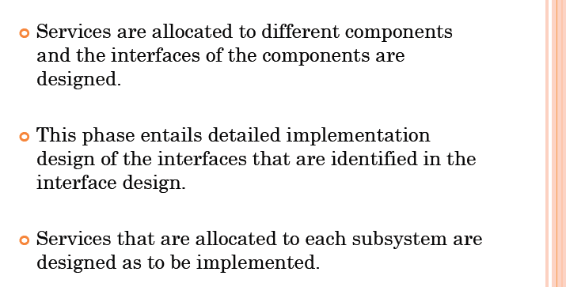
Component design

Slide 11
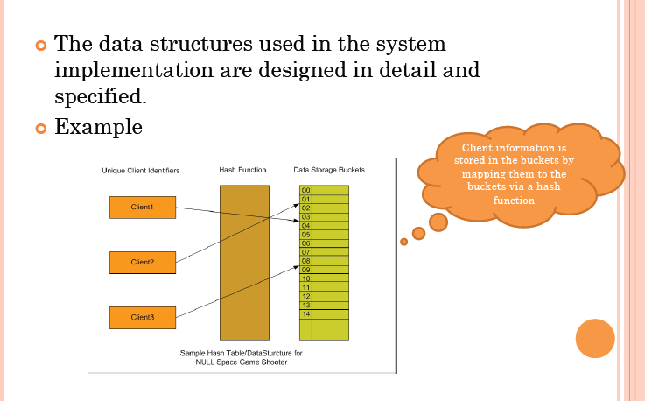
Data structure Design

Slide 12
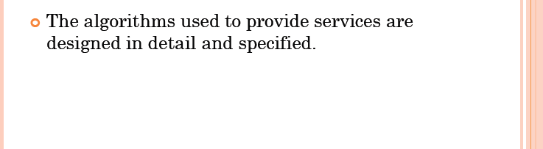
Algorithm Design

Slide 13
General software Design Technique
2 main steps:
  Analysis of problem : Breaking Down, Understanding and clearly Defining
  the Problem
  Design the solution : Finding the Solution(s) to the (Sub-)Problem(s)
  and Constructing the overall solution
Understand the problem and clearly defining it. (very important)
--------------------------------------------------
Develop possible solution(s)
Evaluate the potential solutions
If there is a “best” selection, choose it; otherwise iterate through step 2 again.
Finalize and document the chosen solution

Slide 14
Software software Design Technique (in Activity Diagram)
Software Engineering Design
SRS : Doc
Design Document: Doc
Note:
1. Analysis is
understanding
the SRS
SRS
Engineering Design Analysis
clear Problem
Statements
Generate Possible Solutions
Note:
1. Generate
more than 1
solution
2. Process is
iterative
Candidate
Solutions
Evaluate Candidate Solutions
Select Solution
[else-no solution]
[selected solution]
Selected
Solution
finalize/document the Solution
Design
Document

Slide 15
Modularity
A system is modular if it is composed of well defined, conceptually simple and independent units interacting through well defined interfaces.
The following are several advantages of modular systems.
  Modular systems are easier to understand and explain because their parts make sense and can stand on their own.
  Modular systems are easier to document because each part can be documented as n independent unit.
  Programming individual modules is easier because programmer can focus on just one small, simple problem rather than a large complex problem.
  Testing and debugging individual modules is easier because they can be dealt with in isolation from the rest of the program.
  Bugs are easier to isolate and understand, and they can be fixed without fear of introducing problems outside the module.
  Well composed modules are more reusable because they are more likely to comprise part of a solution of many problems. Also a good module should be easy to extract from any one of the program and insert into another.

Slide 16
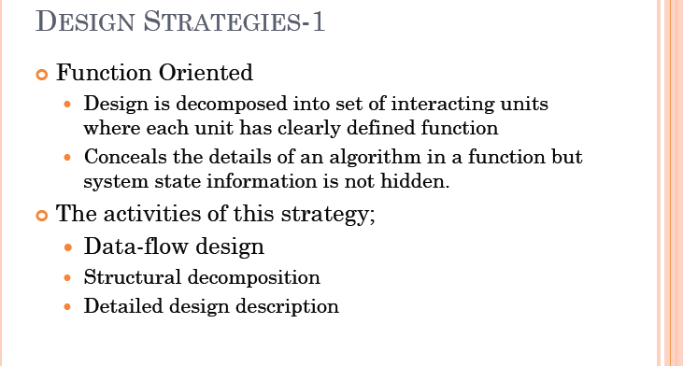
Strategies
Two broad strategies for tackling software design
Function-oriented design:
  Software is structured around a centralized system state
  System state is shared between a collection of functions (subroutines)
Object-oriented design:
  Software is structured around a collection of objects, where each object is responsible for it own state
  Object organized into a class hierarchy, exploiting inheritance

Slide 17
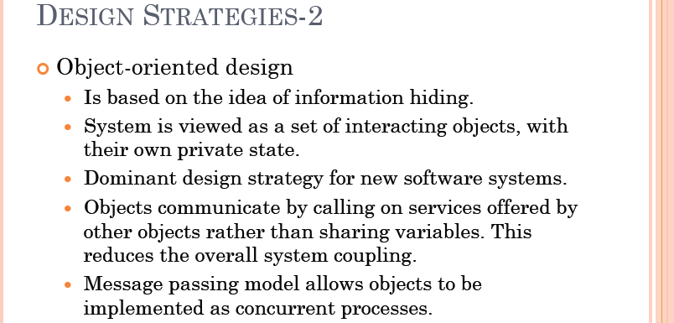

Slide 18
Function oriented design
Function oriented design is the result of focusing attention to the function of the program.
This is based on stepwise refinement. Stepwise refinement is a top down strategy where a program is refined as a hierarchy of increasing levels of detail.
We start with a high level description of what the program does. Then, in each step, we take one part of our high level description and refine it, i.e., specify in somewhat greater detail what that particular does.
The process should proceed from a highly conceptual model (abstractions) to lower level details.
The refinement of each module is done until we reach the statement level of our programming language. At that point, we can describe the structure of our program as a tree of refinement in top down design structure.
Some of the nodes of the tree will be modules of the program
Others will be simply statements.

Slide 19
Function oriented design
A system is viewed as something that performs a set of functions. Starting at this high-level view of the system, each function is successively refined into more detailed functions. For example, consider a function create-new-library-member which essentially creates the record for a new member, assigns a unique membership number to him, and prints a bill towards his membership charge. This function may consist of the following sub-functions:
• assign-membership-number
• create-member-record
• print-bill
Each of these sub-functions may be split into more detailed sub functions and so on.
The system state is centralized and shared among different functions, e.g. data such as member-records is available for reference and updating to several functions such as:
  create-new-member
  delete-member
  update-member-record

Slide 20
Object oriented design
It is the result of focusing attention not on the function performed by the program, but instead on the data that is to be manipulated by the program.
OOD is one of the latest approaches to software development and it shows much promise in solving the problems associated with building modern software system.
Object: Software packages designed and developed to correspond with real world entities that contains all the data and services required to function as their associated entities messages.
Methods: Methods are services that objects perform to satisfy the functional requirements of the problem domain. Object request services of other objects through message passing.
Benefits of OOD
  Objects are inherently reusable.
  The characteristics of information hiding stabilizes systems by localizing changes to objects.
  The concept of objects performing services is a more natural way of thinking.

Slide 21
Object oriented design
In the object-oriented design approach, the system is viewed as collection of objects (i.e. entities).
The state is decentralized among the objects and each object manages its own state information.
For example, in a Library Automation Software, each library member may be a separate object with its own data and functions to operate on these data.
In fact, the functions defined for one object cannot refer or change data of other objects.
Objects have their own internal data which define their state.
Similar objects constitute a class.
In other words, each object is a member of some class. Classes may inherit features from super class.
Conceptually, objects communicate by message passing.

Slide 22
Function oriented vs Object oriented design
Unlike function-oriented design methods, in OOD, the basic abstraction are not real-world functions such as sort, display, track, etc, but real-world entities such as employee, picture, machine, radar system, etc.
For example in OOD, an employee pay-roll software is not developed by designing functions such as update-employee-record, get-employee-address, etc. but by designing objects such as employees, departments, etc.
Grady Booch sums up this difference as “identify verbs if you are after procedural design and nouns if you are after object-oriented design”
In OOD, state information is not represented in a centralized shared memory but is distributed among the objects of the system.

Slide 23
Function oriented vs Object oriented design
For example, while developing an employee pay-roll system, the employee data such as the names of the employees, their code numbers, basic salaries, etc. are usually implemented as global data in a traditional programming system; whereas in an object-oriented system these data are distributed among different employee objects of the system. Objects communicate by message passing. Therefore, one object may discover the state information of another object by interrogating it.
In OOD, the functions are usually associated with specific real-world entities (objects); they directly access only part of the system state information.
Function-oriented techniques such as SA/SD group functions together if, as a group, they constitute a higher-level function. On the other hand, object-oriented techniques group functions together on the basis of the data they operate on.

Slide 24
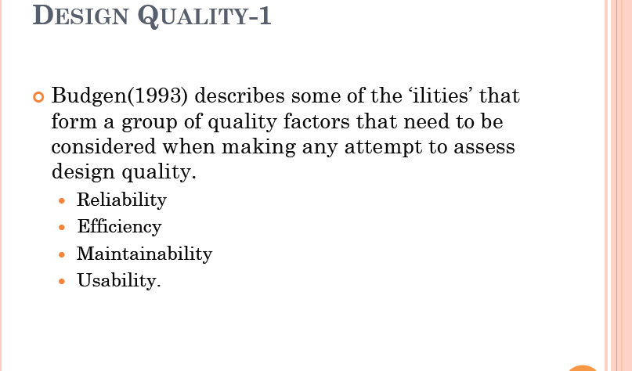

Slide 25
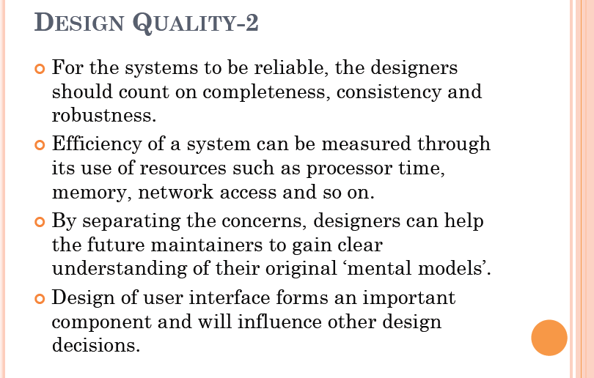

Slide 26
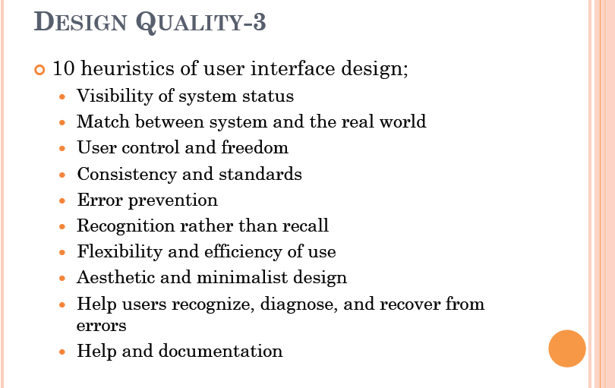

Slide 27
Quality
Cohesion:
  Most researchers and engineers agree that a good software design implies clean decomposition of the problem into modules, and the neat arrangement of these modules in a hierarchy. The primary characteristics of neat module decomposition are high cohesion and low coupling. Cohesion is a measure of functional strength of a module.
  A measure of how well the parts of a component fit together, i.e. how functionally related the parts are
  For example, strong cohesion exists when all parts of a component contribute different aspects of related functions
  Strong cohesion promotes understanding and reasoning, and thus provides dividends with respect to maintenance and reuse via separation of concerns

Slide 28
Cohesion
Coincidental cohesion: A module is said to have coincidental cohesion, if it performs a set of tasks that relate to each other very loosely, if at all. In this case, the module contains a random collection of functions. It is likely that the functions have been put in the module out of pure coincidence without any thought or design. For example, in a transaction processing system (TPS), the get-input, print-error, and summarize-members functions are grouped into one module. The grouping does not have any relevance to the structure of the problem.
Logical cohesion: A module is said to be logically cohesive, if all elements of the module perform similar operations, e.g. error handling, data input, data output, etc. An example of logical cohesion is the case where a set of print functions generating different output reports are arranged into a single module.
Temporal cohesion: When a module contains functions that are related by the fact that all the functions must be executed in the same time span, the module is said to exhibit temporal cohesion. The set of functions responsible for initialization, start-up, shutdown of some process, etc. exhibit temporal cohesion.

Slide 29
Cohesion
Procedural cohesion: A module is said to possess procedural cohesion, if the set of functions of the module are all part of a procedure (algorithm) in which certain sequence of steps have to be carried out for achieving an objective, e.g. the algorithm for decoding a message.
Communicational cohesion: A module is said to have communicational cohesion, if all functions of the module refer to or update the same data structure, e.g. the set of functions defined on an array or a stack.
Sequential cohesion: A module is said to possess sequential cohesion, if the elements of a module form the parts of sequence, where the output from one element of the sequence is input to the next. For example, in a TPS, the get-input, validate-input, sort-input functions are grouped into one module.

Slide 30
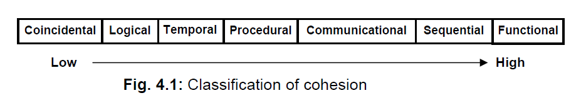
Cohesion
Functional cohesion: Functional cohesion is said to exist, if different elements of a module cooperate to achieve a single function. For example, a module containing all the functions required to manage employees’ pay-roll exhibits functional cohesion. Suppose a module exhibits functional cohesion and we are asked to describe what the module does, then we would be able to describe it using a single sentence.

Slide 31
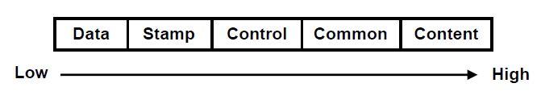
Coupling
Coupling between two modules is a measure of the degree of interdependence or interaction between the two modules. A module having high cohesion and low coupling is said to be functionally independent of other modules. If two modules interchange large amounts of data, then they are highly interdependent. The degree of coupling between two modules depends on their interface complexity.
The interface complexity is basically determined by the number of types of parameters that are interchanged while invoking the functions of the module.
Even if there are no techniques to precisely and quantitatively estimate the coupling between two modules, classification of the different types of coupling will help to quantitatively estimate the degree of coupling between two modules. Five types of coupling can occur between any two modules.

Slide 32
Coupling
Data coupling: Two modules are data coupled, if they communicate through a parameter. An example is an elementary data item passed as a parameter between two modules, e.g. an integer, a float, a character, etc. This data item should be problem related and not used for the control purpose.
Stamp coupling: Two modules are stamp coupled, if they communicate using a composite data item such as a record in PASCAL or a structure in C.
Control coupling: Control coupling exists between two modules, if data from one module is used to direct the order of instructions execution in another. An example of control coupling is a flag set in one module and tested in another module.

Slide 33
Coupling
Control coupling: Control coupling exists between two modules, if data from one module is used to direct the order of instructions execution in another. An example of control coupling is a flag set in one module and tested in another module.
Common coupling: Two modules are common coupled, if they share data through some global data items.
Content coupling: Content coupling exists between two modules, if they share code, e.g. a branch from one module into another module.

Slide 34
Functional Independent
A module having high cohesion and low coupling is said to be functionally independent from other modules.
By the term functional independence, we mean that a cohesive module performs a single task or function.
A functionally independent module has minimal interaction with other modules.
Functional independence is a key to good design primarily due to the following reasons.
  Functional independence reduces error propagation. Therefore, error existing in one module doesn’t directly affect other modules and also any error existing in other modules don’t directly affect that particular module.
  Reuse of the module is possible, because each module performs some well defined and precise function and the interface of the module with other modules is simple and minimal. Therefore, any such module can be easily taken out and reused in a different program.
  Complexity of the design is reduced, because different modules can be understood in isolation as modules are more or less independent from each other.

